Slide 1
Good practices in using open source tools for reproducible science
Alexandros Kanterakis
kantale@ics.forth.gr
21 November 2020

Slide 2
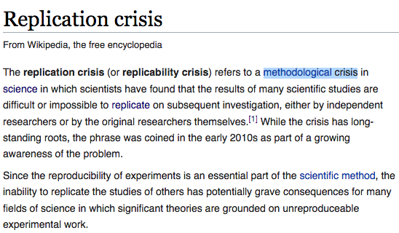
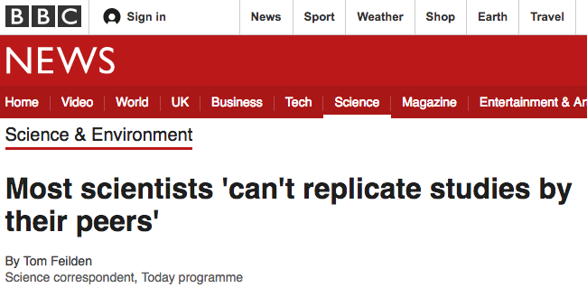
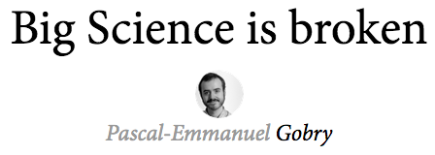
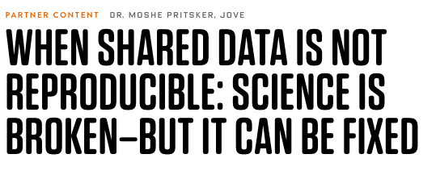
Replication Crisis

Slide 3
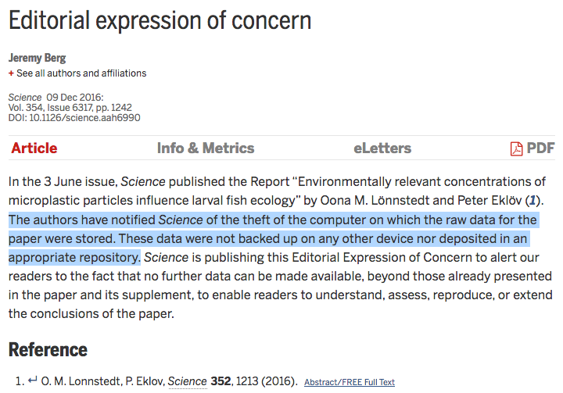

Slide 4
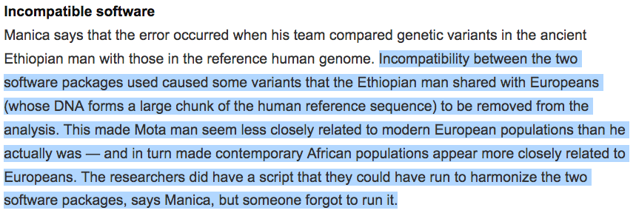

Slide 5
Not that funny..
Affects health care
Below Expectations progress in cancer mortality
Studies that established widely spread clinical practices could not get replicated.
Wastes / Reduces funding
US$ 28 billion preclinical studies that are not reproducible
Failures to reproduce data are followed by a 50–73% drop in NIH funding
Erodes the public belief in science!
“Despite increasing education levels, the public’s trust in the scientific community has been decreasing”
Gauchat, Gordon. "Politicization of science in the public sphere: A study of public trust in the United States, 1974 to 2010." American sociological review 77.2 (2012): 167-187.

Slide 6
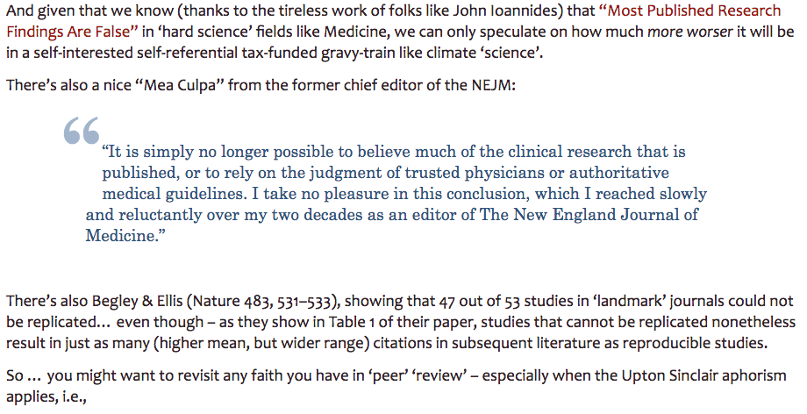
Copy pasted from a “climate skeptic” site:

Slide 7
Have you ever..
Spend weeks to install an academic software, even if the code is open source?
Unable to reproduce a simple plot from an academic paper?
Try to connect the output of a tool to the input of another with no avail?
Moved all your data to specific directory structure + change format to make a software “happy”?
Downgrade your OS/libraries to meet specific requirements?
Suspect that the authors are making this tool un-runable in purpose?

Slide 8
I am not sharing my data/code because
It is not a prerequisite from my institution/funding agency/employer to publish data.
I can build a high h-index, without publishing data
My data is not essential for my work! It is secondary / supplementary material
My data is in my own defined (superior!) format, hence unusable to others!
I don’t have the budget to adhere to open standards.
I will be bombarded with emails about the specifics of my data.
I am doing a controversial science, I might be misunderstood..

Slide 9
I am not publishing code/data because
Lack of specific repositories (i.e. earth sciences, humanities)
Insufficient infrastructure for transferring big data
Security / Privacy
I am publishing… In my institute/computer/silo …
I do not have the budget for a personal to (1) write documentation (2) maintain code, (3) publish in a repository. Research funds have expiration date!
My data is too big to publish them (no thay are not, unless you CERN)

Slide 10
I am not publishing my data/code because
It is not that interesting / it is that good
It is unpublished work
I cannot extract the data from my machine! (i.e. a database that I don’t know how to create a dump)
Legal issues forbid us!
It is not mine.. (part of the ) data come from a collaborator.
I am not sure my boss will be happy if I publish data/code
It’s incomplete. We are still gathering/polishing/…
It is already published (in my private website, repository, …)

Slide 11
I am not publishing the data because
”Data are available upon contacting the corresponding author”
What is it for me?

Slide 12
What they really mean is:
I am afraid I might be “scooped”
Others will take advantage of my intellectual property

Slide 13
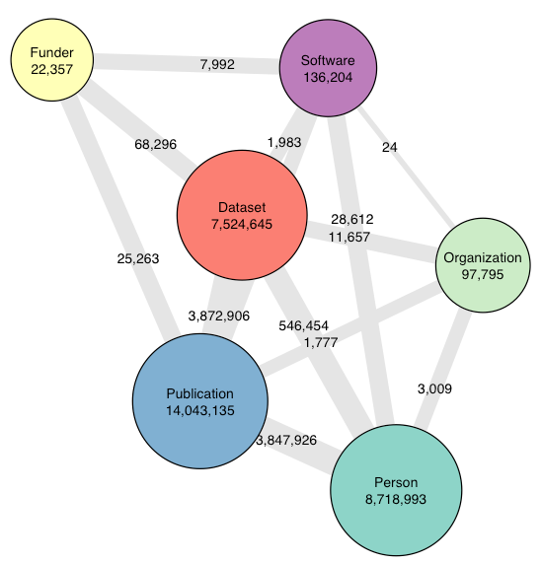
Why go open as an academic
culture of collaboration
push for sharing → push for improvement
Profile building
The dark matter of scientific output
Even if you are a “selfish” academic (“I don’t care about science, I care about recognition”), you still have to go open!
https://github.com/datacite/pidgraph-notebooks-r/tree/master/kpi
17.500 tools https://bio.tools/stats

Slide 14
The reason why you have to go open reproducible is not only: “it is good for science” But because “You have to”

Slide 15
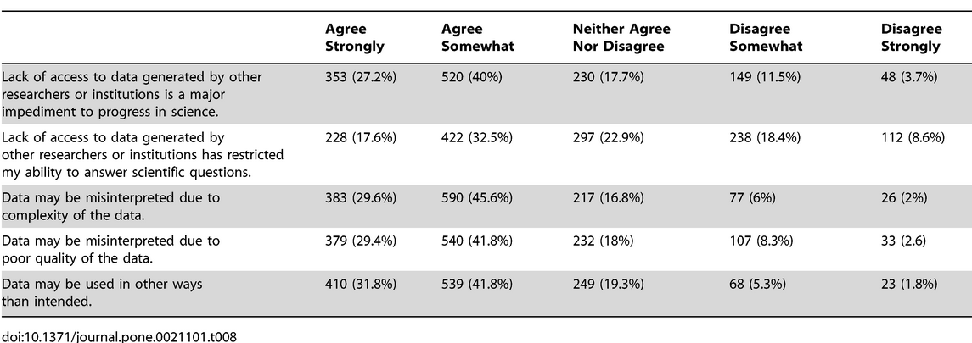
Do you think that data should be Open?
Scientist: YES!
Do you share your data?
Scientists: YES!
Can other scientists access your data?
Scientists: Well..
Tenopir, Carol, et al. "Data sharing by scientists: practices and perceptions." PloS one 6.6 (2011): e21101.

Slide 16
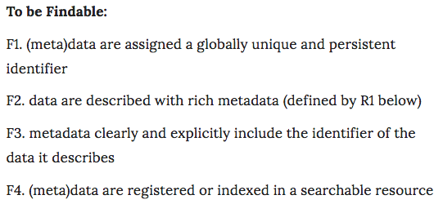
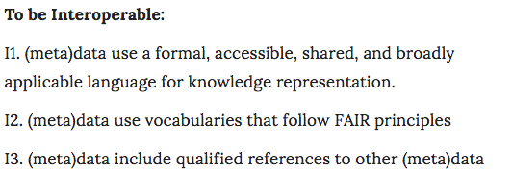
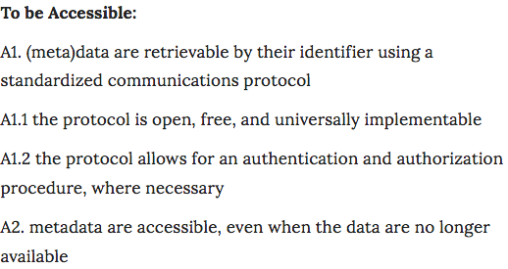
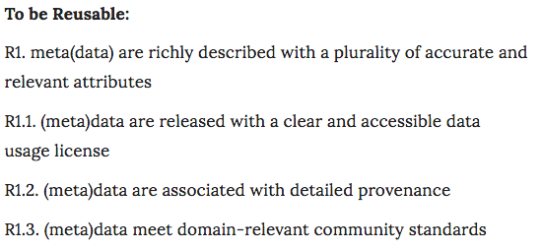
Wilkinson, Mark D., et al. "The FAIR Guiding Principles for scientific data management and stewardship." Scientific data 3 (2016): 160018.

Slide 17
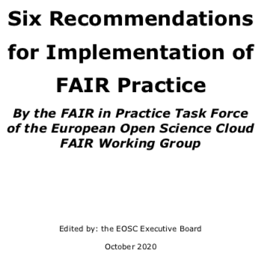
FAIR ≠ Open Data
Data that require authentication and authorization, can be open

Slide 18
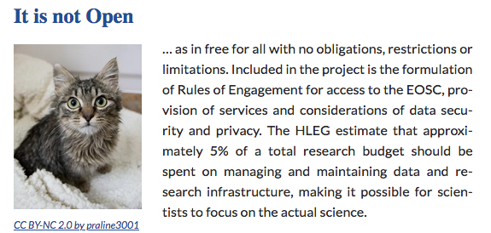
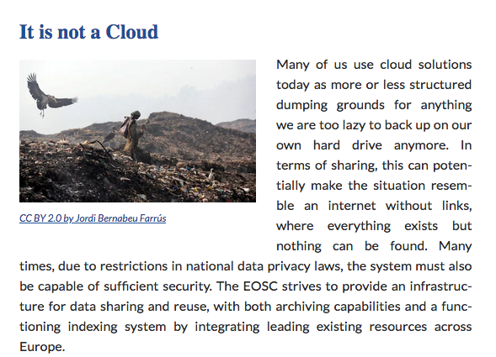
https://www.euroscientist.com/european-open-science-cloud-really/

Slide 19
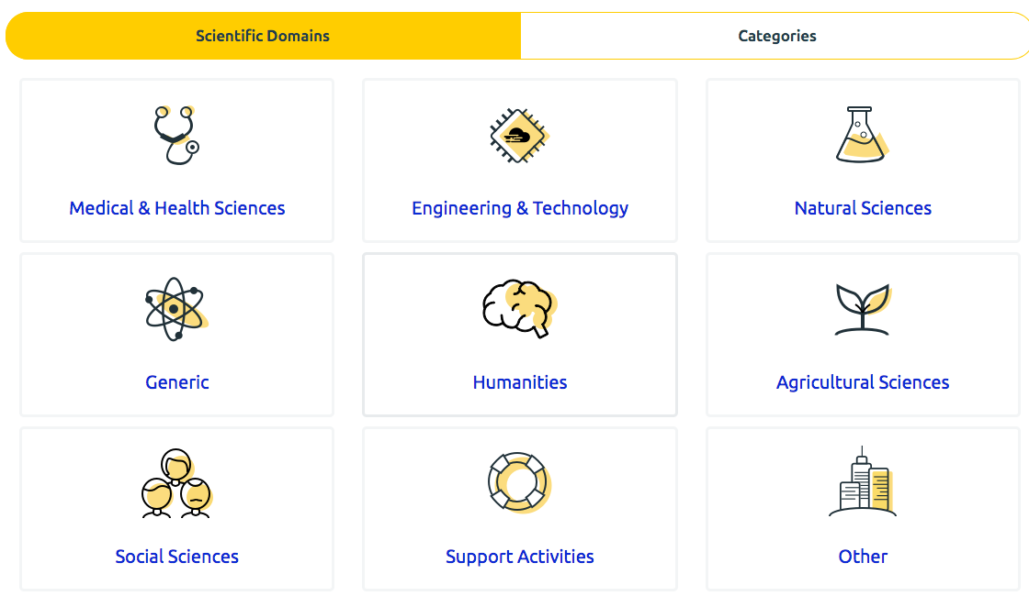
https://marketplace.eosc-portal.eu/

Slide 20
https://ec.europa.eu/info/funding-tenders/opportunities/portal/screen/opportunities/topic-details/dt-tds-04-2020

Slide 21
https://ec.europa.eu/research/participants/data/ref/h2020/grants_manual/hi/oa_pilot/h2020-hi-oa-data-mgt_en.pdf

Slide 22
https://wellcome.org/grant-funding/guidance/good-research-practice-guidelines

Slide 23
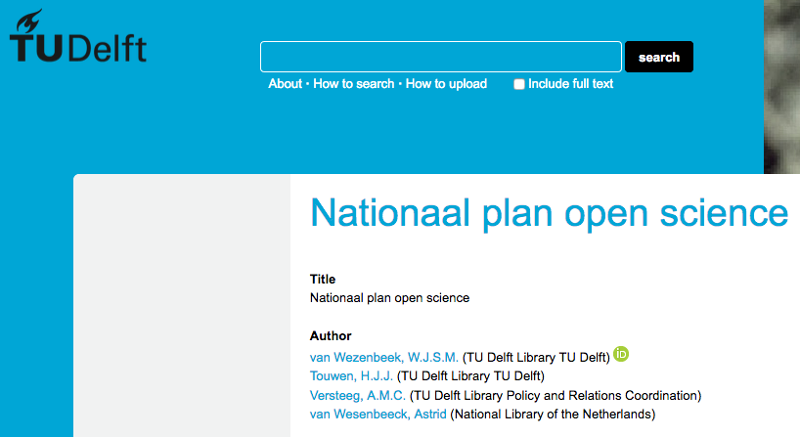
National efforts

Slide 24
https://d1rkab7tlqy5f1.cloudfront.net/Library/Themaportalen/RDM/researchdata-framework-policy.pdf

Slide 25
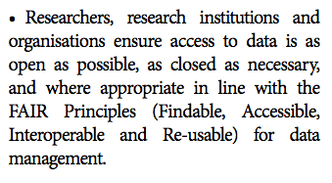
http://www.allea.org/wp-content/uploads/2017/03/ALLEA-European-Code-of-Conduct-for-Research-Integrity-2017-1.pdf

Slide 26
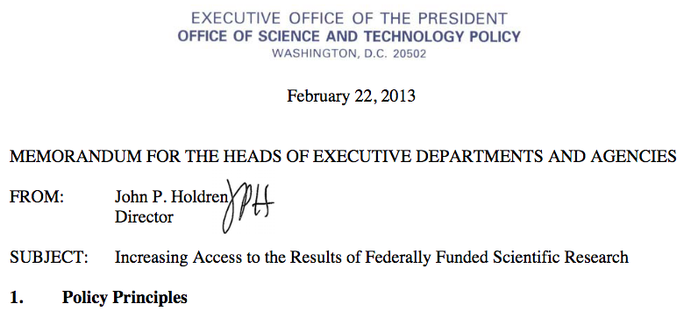
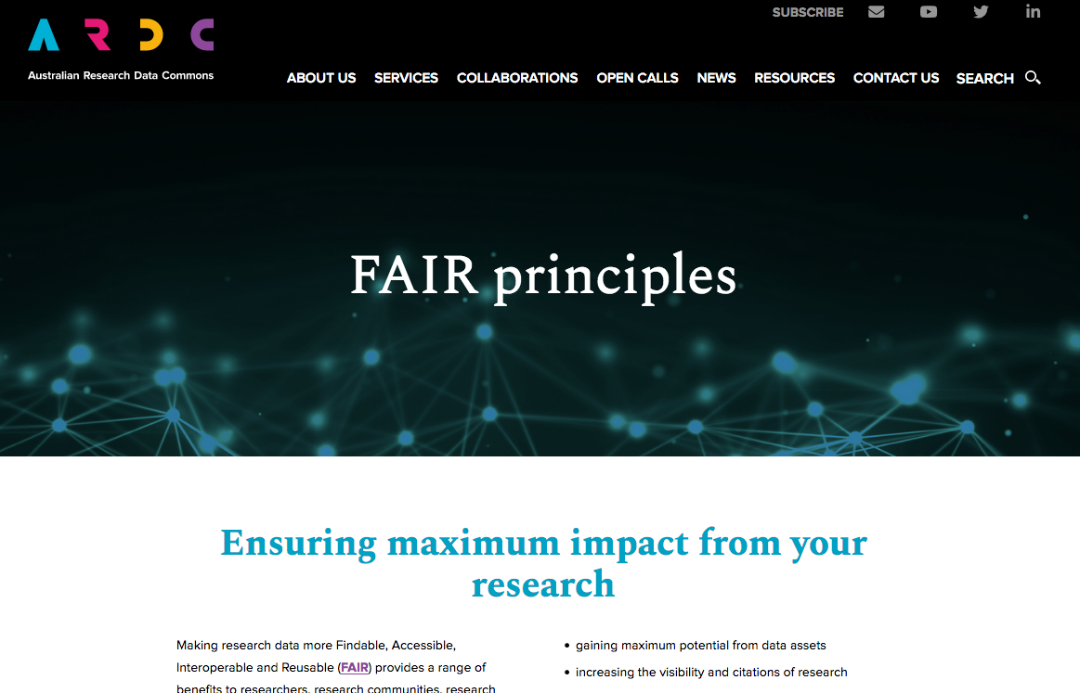
https://obamawhitehouse.archives.gov/sites/default/files/microsites/ostp/ostp_public_access_memo_2013.pdf
https://www.federalregister.gov/documents/2020/02/19/2020-03189/request-for-information-public-access-to-peer-reviewed-scholarly-publications-data-and-code
https://www.go-fair.org/wp-content/uploads/2019/08/Activity-Plan-with-the-Manifesto-of-the-GO-FAIR-in-AFRICA-Final-1-August-2019.pdf
https://ardc.edu.au/collaborations/fair-principles/

Slide 27
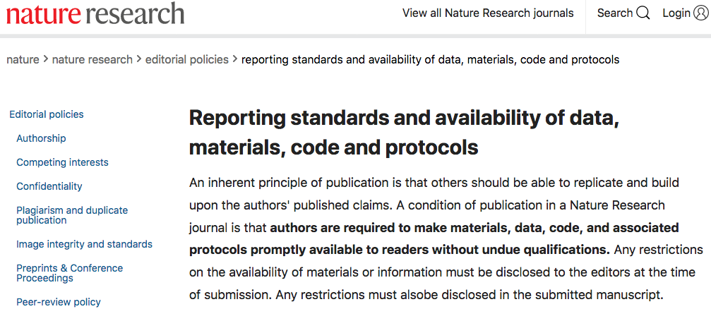
Journals want open data/code

Slide 28
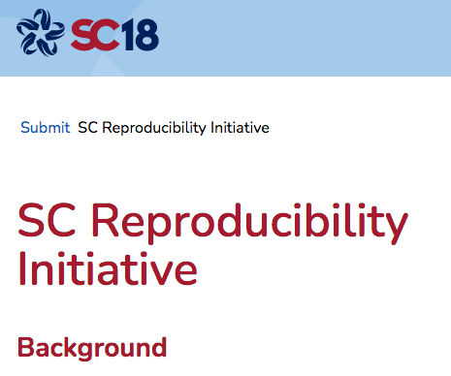
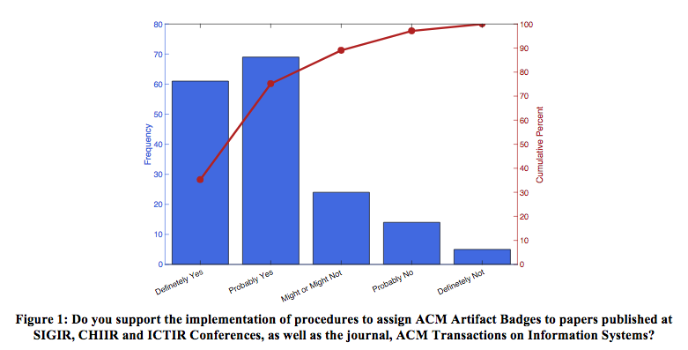
(Serious) conferences want open data/code
Ferro, Nicola, and Diane Kelly. "SIGIR initiative to implement ACM artifact review and badging." ACM SIGIR Forum. Vol. 52. No. 1. New York, NY, USA: ACM, 2018.

Slide 29
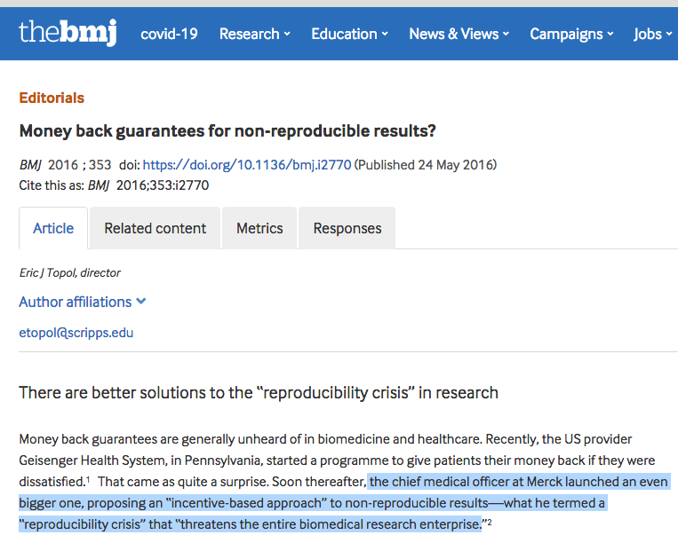
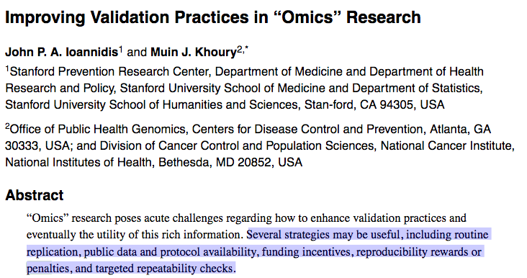
Penalty / Reward system
Ioannidis, John PA, and Muin J. Khoury. "Improving validation practices in “omics” research." Science 334.6060 (2011): 1230-1232.
https://www.bmj.com/content/353/bmj.i2770

Slide 30
Make source code publicly accessible from day one
Promotes trust in the software and broader project
Facilitates the discovery of existing software development projects
Provides a historical public record of contributions from the start of the project and helps to track recognition
Encourages contributions from the community
Increases opportunities for collaboration and reuse
Exposes work for community evaluation, suggestions and validation
Increases transparency through community scrutiny
Encourages developers to think about and showcase good coding practices
Facilitates reproducibility of scientific results generated by all prior versions of the software
Encourages developers to provide documentation, including a detailed user manual and clear in-code comments
Jiménez, Rafael C., et al. "Four simple recommendations to encourage best practices in research software." F1000Research 6 (2017).

Slide 31
Make software easy to discover by providing software metadata via a popular community registry
Increases the visibility of the project, the software, its use, its successes, its references, and its contributors
Helps to expose the software metadata in a machine readable format via the community registry
Increases the chances of collaboration, reuse, and improvement
Domain specific tool repositories:
Astronomy: https://ascl.net/
Bioinformatics: https://bio.tools
GeoSciences: https://www.ontosoft.org/
Jiménez, Rafael C., et al. "Four simple recommendations to encourage best practices in research software." F1000Research 6 (2017).

Slide 32
Adopt a license and comply with the license of third-party dependencies
Clarifies the responsibilities and rights placed on third parties wishing to use, copy, redistribute, modify and/or reuse your source code
Enables using the code in jurisdictions where “code with no license” means it cannot be used at all
Protects the software’s intellectual property
Provides a model for long-term sustainability by enabling legally well-founded contributions and reuse
Jiménez, Rafael C., et al. "Four simple recommendations to encourage best practices in research software." F1000Research 6 (2017).

Slide 33
Define clear and transparent contribution, governance and communication processes
Increases transparency on how the project and the software is being managed
Helps to define responsibilities and how decision are made in the software project
Helps the community know how to collaborate, communicate and contribute to the project

Slide 34
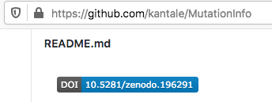
More concrete..
Add README and License
23.6% do not have a License or README. This is the main criteria for reproducibility [1]
Add DOIs in Github repositories
Cite everything:
CiteAs.org
Use ORCID
Build Docker / Singular images. Save in CernVM
[1] Whitaker, K., O’Reilly, M., , Isla, & Hong, N. C. (2018). Softwaresaved/Code-Cite: Sn-Hackday Version. Zenodo. https://doi.org/10.5281/ZENODO.1209095

Slide 35
On coding
Use idioms and conventions
Avoid assumptions about the execution environment
Structure your code in predictable way
Document everything
Test everything
Simplify code execution. Always assume that a non-IT savvy student is trying to run your code

Slide 36
On formats
I hate to break the news to you but these formats are not reproducible by default
CSV
SPSS
Matlab
JSON
.rdata
.npy

Slide 37
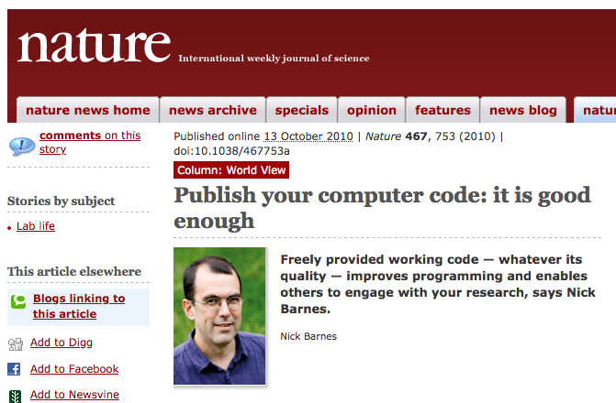
And remember: “bad code” is better than “no code”
https://www.nature.com/news/2010/101013/full/467753a.html

Slide 38
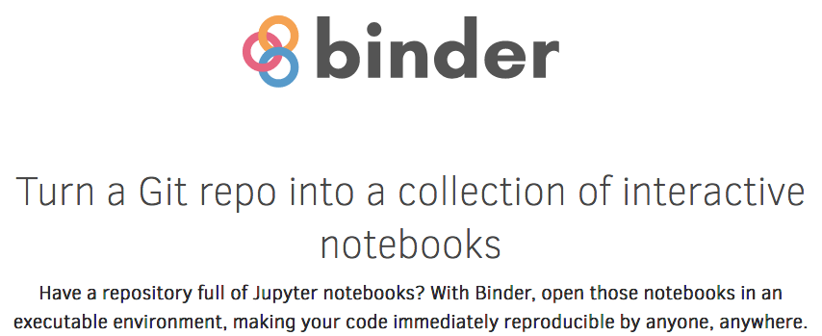
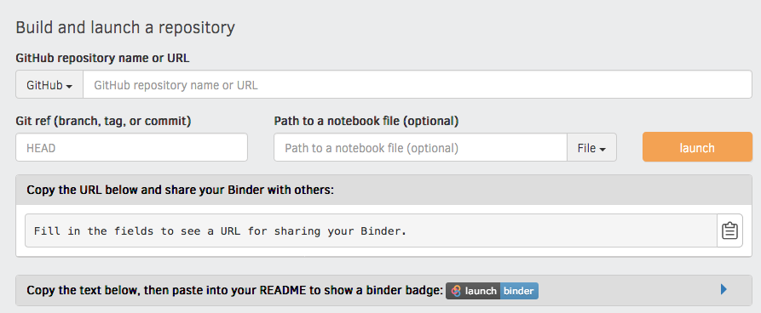
Make your paper executable

Slide 39
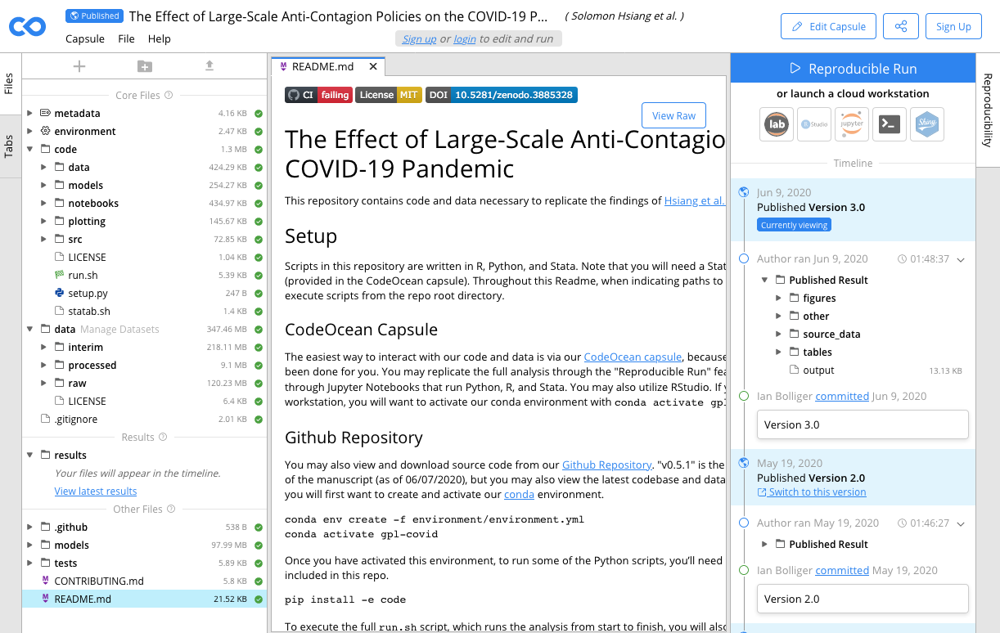
Make your paper executable
https://codeocean.com

Slide 40
Analysis Environments
Forget “programs”, “scripts”, we need something bigger..
Containers: Docker, Singularity
Workflow Management Systems: Galaxy, Nextflow, Snakemake
Workflow Engines: Airflow, Argo
Workflow Ontologies: CWL, WDL
Deployment environments: Arvados, Toil
Low latency databases: Spark, Hadoop
Good news: All are open and free!

Slide 41
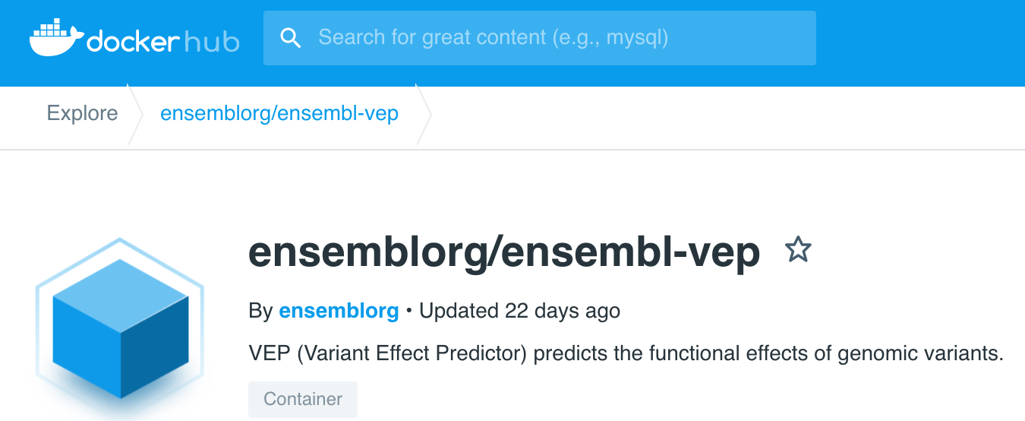
Containers
Run any operating system in any operating system
Run multiple operating systems in the same computer
Share resources
Forget dependencies, If it is installed “somewhere” can be installed anywhere
Containers are simple sharable files
Specialized container repositories for bioinformatics
2 flavors: Docker, Singularity

Slide 42
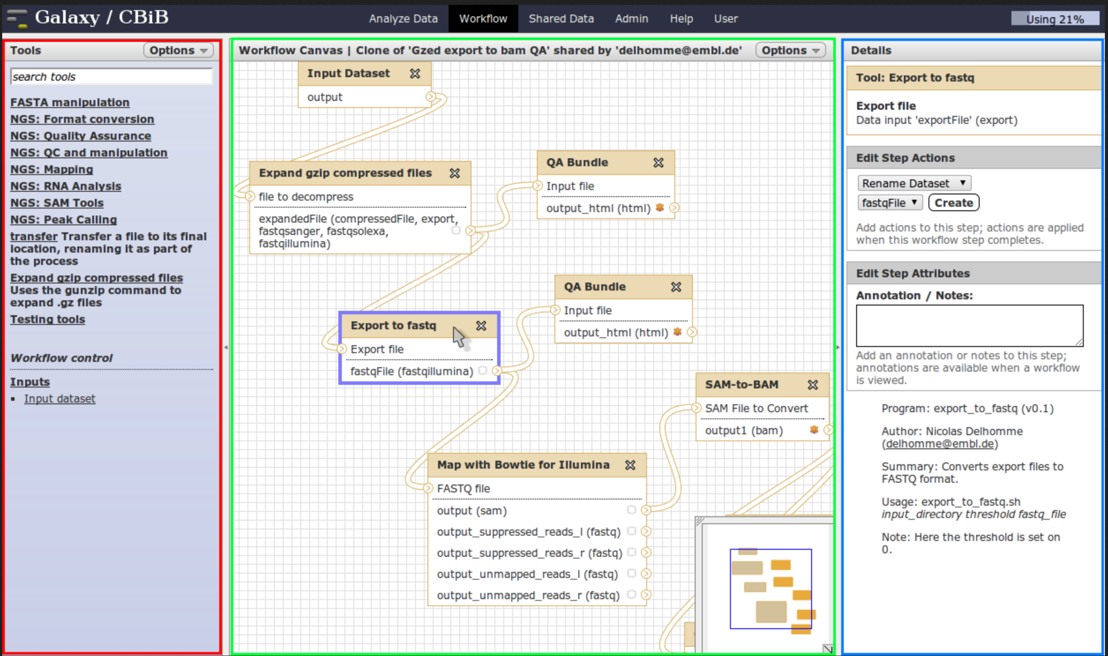
Workflow Management Systems
Tools, Data are Research Object (ROs)
Organize ROs in Workflows
Workflows are ROs!
ROs can be indexed, searched, commented, rated, shared, edited..
Visual Representation of Workflows
ROs can be executed, monitored, logged
Most notable are:
Galaxy, Nextflow, Taverna, Snakemake

Slide 43
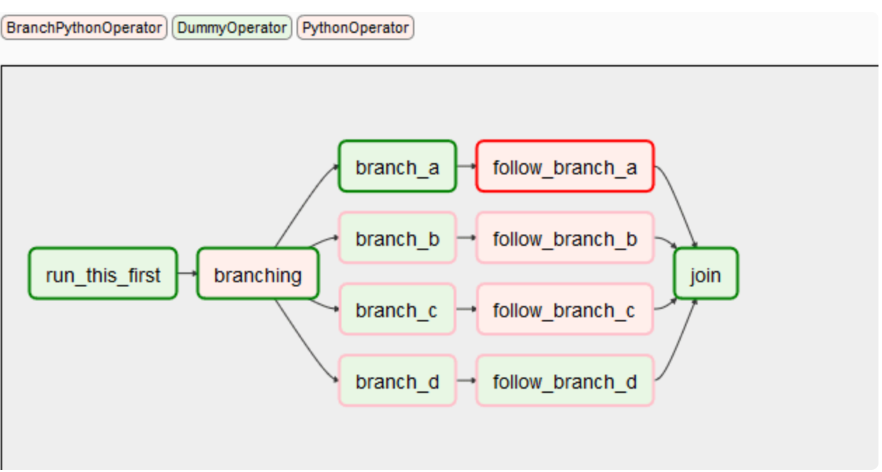
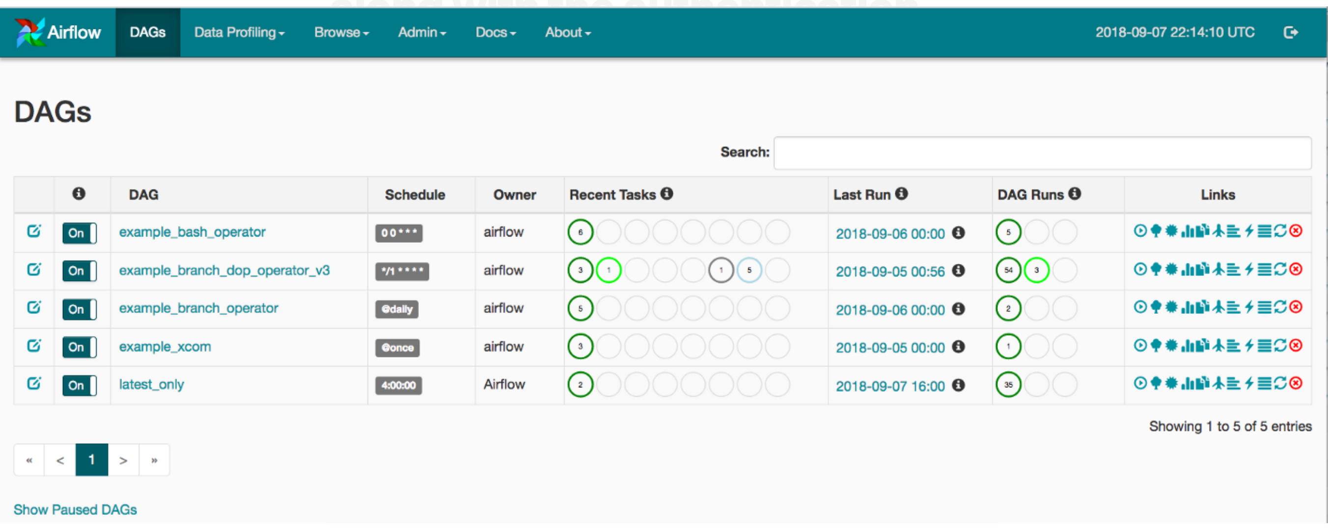
Workflow Engines
Execute Workflows
Main operations: Submit, Monitor, Pause, Cancel
Schedule execution
Assign Resources
Scale automatically
Workflows can be scripts, containers

Slide 44
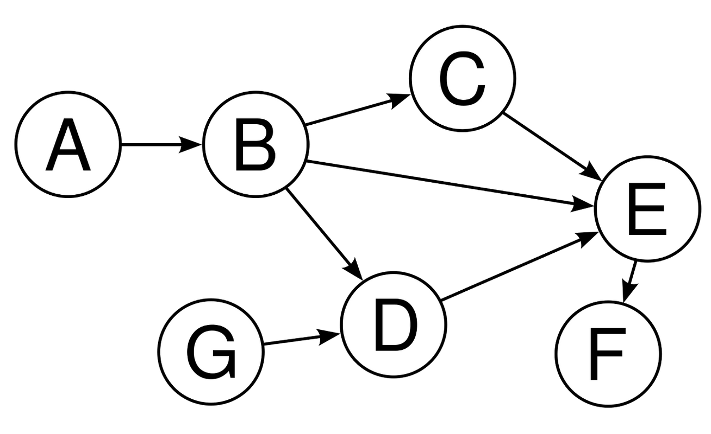
Workflow Ontologies
Simple languages to describe workflows
In most of them workflows are DAG (Direct Acyclic Graph)
Most notable: Common Workflow Language (CWL),
More than 60,000 can be found in Github
Actively supported by:
Organizations: EMBL, ELIXIR, IBM, CERN, EOSC, Welcome Trust Sanger Institute, Broad Institute
WMS: Galaxy, Taverna
Workflow Execution Engines: Airflow

Slide 45
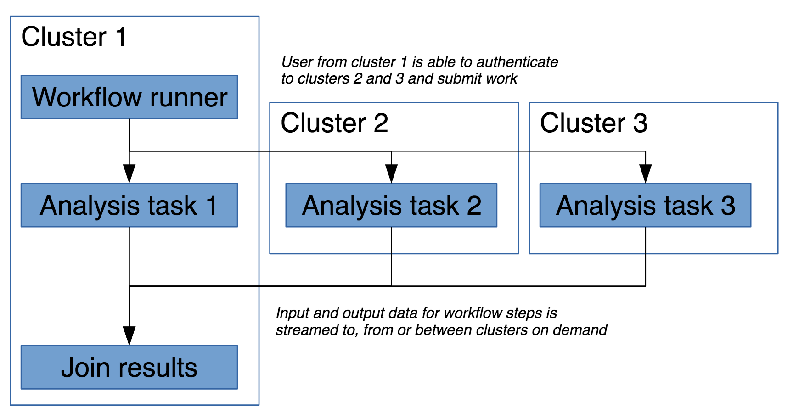
Deployment environments
Software to orchestrate the deployment of a workflow in different execution environments such as:
Cloud: Amazon EC2, Google Cloud, Microsoft Azure
Local Cluster with resource management: PBS, Torque, SLURM
Workstation
A combination of all these!
Most notable: Arvados

Slide 46
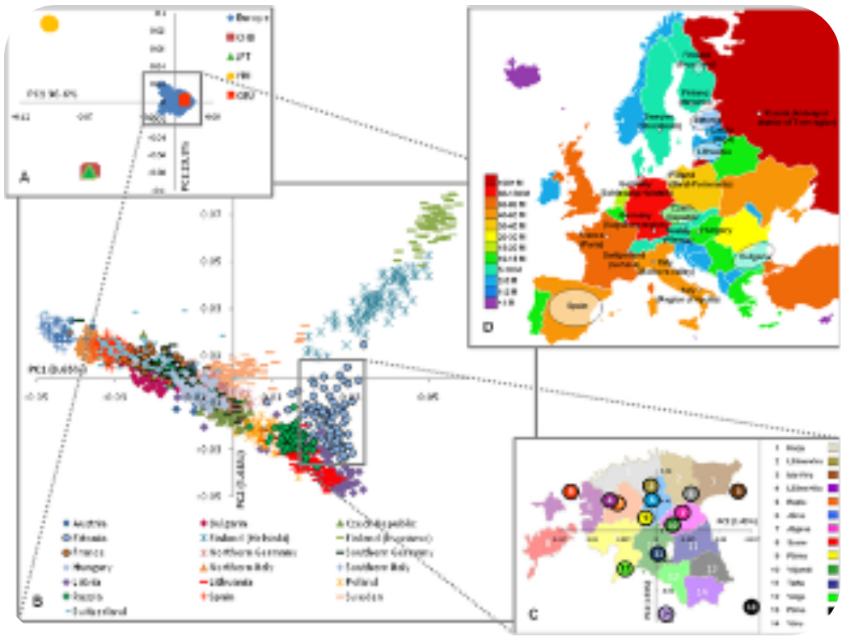
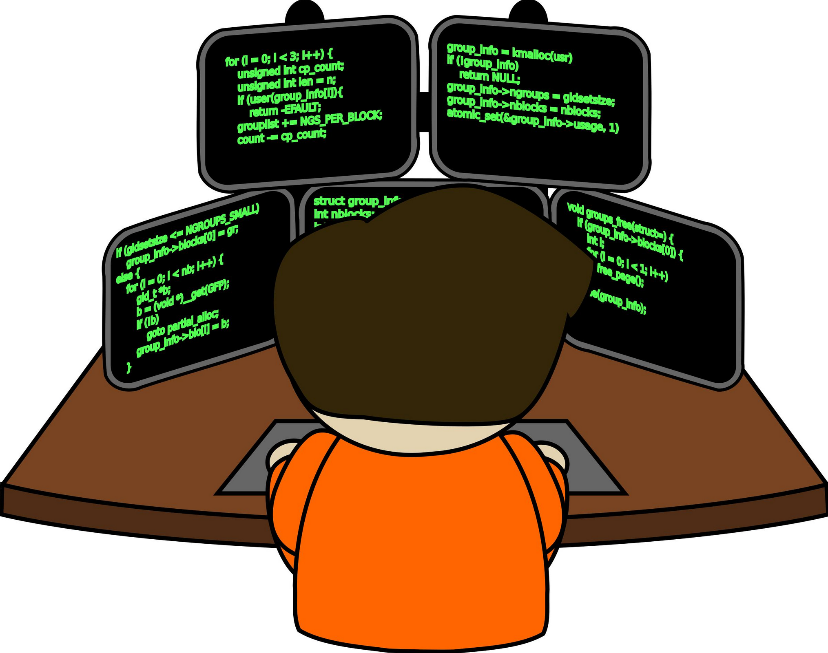
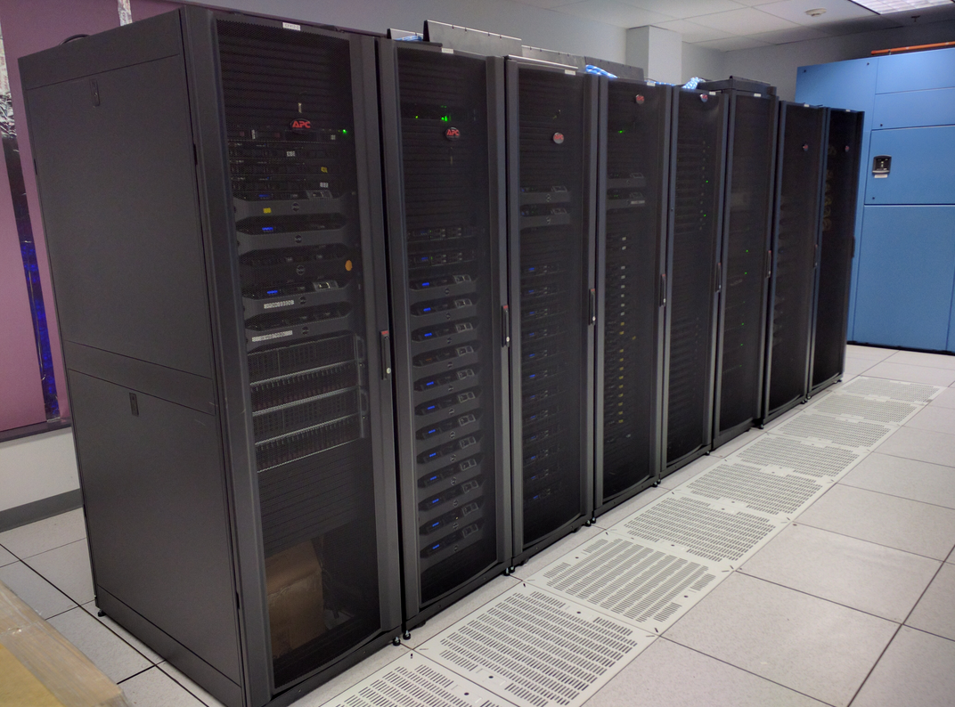
The old paradigm in bioinformatics… issues..
In-house programmer / data analyst
Data
Institute’s cluster
Results!
Not enough!
Couple with online DBs
Follow external QC pipelines
Standards / Format
There was an error, we need to redo the analysis!
Significant? Enough statistical power?
Store for future
statistics / Ontology / systems / bio / expert
Install and manage external libraries and tools
Tools don’t run in our cluster!
Too weak/too busy
Legal issues with external data!

Slide 47
Fragile pipelines: Analysis gets rotten by the time..
Script that assumes all dates are before 2000
The R script that has a missing dependency
The python script that relies in an older/obsolete version of python
The script from that student that left years ago
Data in a format that is no longer supported from the analysis software
Database that changed data model
Program that only runs on that computer that caught fire

Slide 48
The new paradigm in bioinformatics
Data
Institute’s cluster
External cluster with medical data
National infrastructure
Paid service (i.e. amazon cloud)
Deploy
&
Monitor
Download
Design
Containers
Tool 1
Results
Tool 2
Combine all components in a Workflow
Workflow 1
Database 1

Slide 49
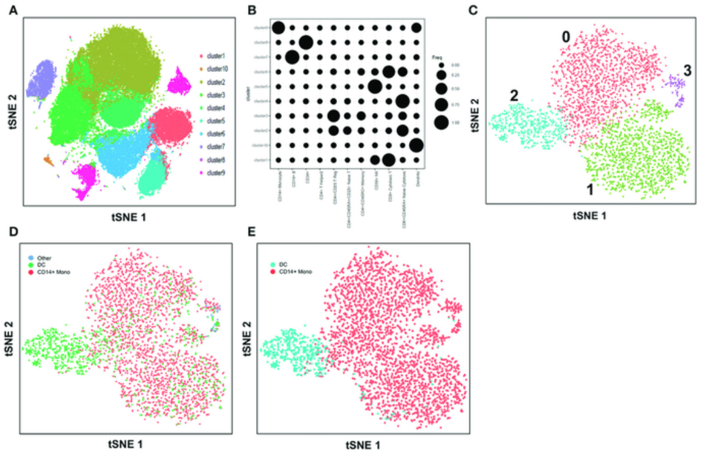
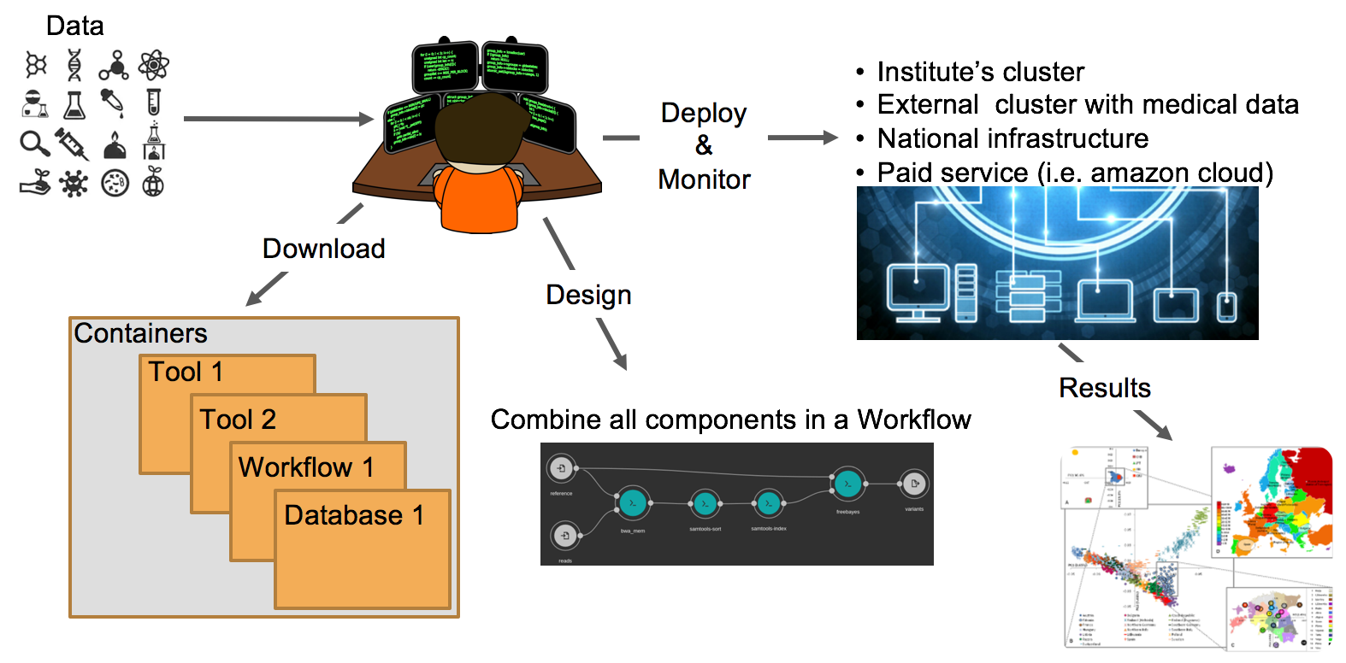
Reproducibility + Provenance = Iterative process
New Data
Download
Containers
New results
Tool 5
Workflow A
Database B
Old Results

Slide 50
OpenBio.eu --- WHY?
I want to run this Galaxy workflow,
then apply this perl script that I found in github,
Then visualize the results with my nextflow script,
wrap everything in CWL and…
run it in my weirdly configured institution cluster
Some will say: this is un-maintainable, un-versionable, un-implementable, un-scalable…
Current solutions: too locked in..

Slide 51
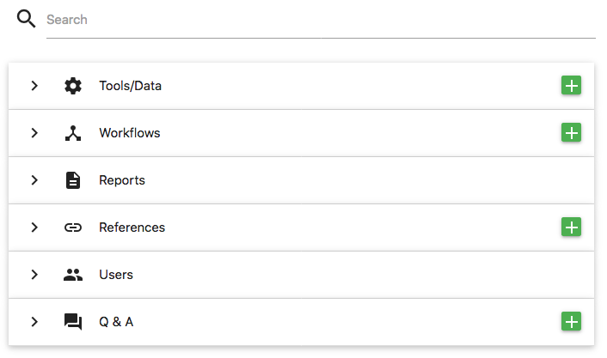
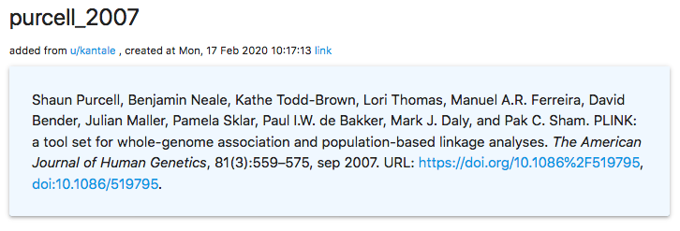
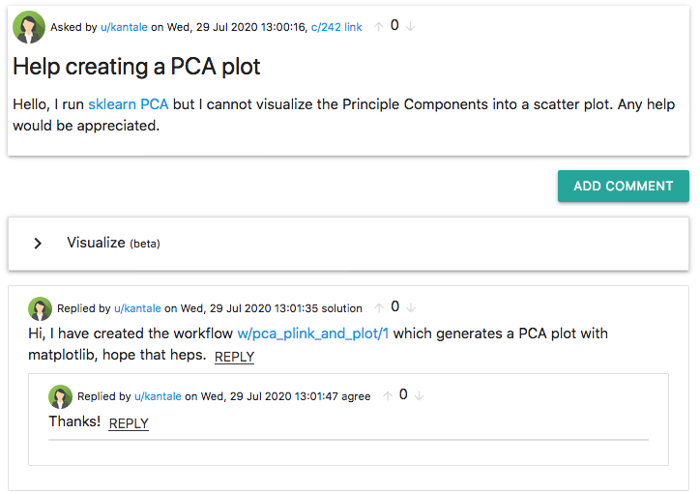
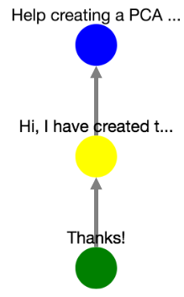
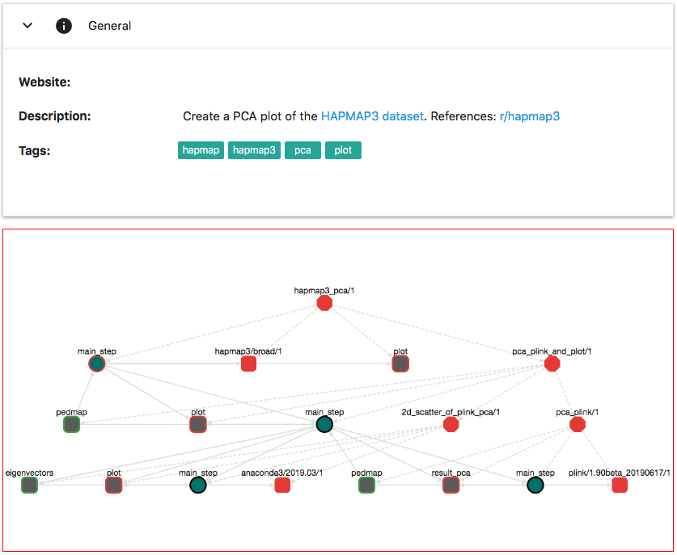
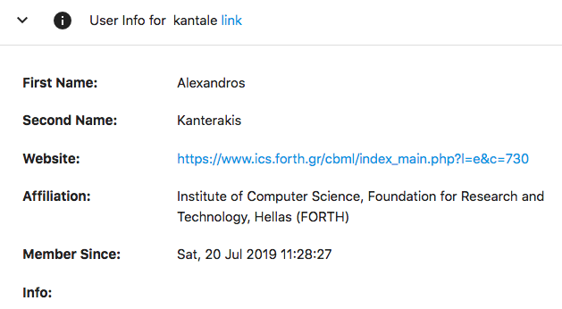
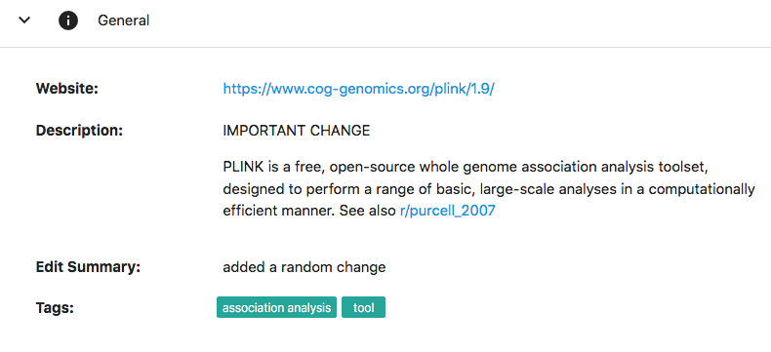
OpenBio.eu – A Research Object (RO) Repository
Search
Data
References
Discussion
Directly Run/Rate/Comment/Edit/Combine any RO
Language agnostic! Use bash, python, R, java, perl, …
Get credit when other users use your ROs
Request help, build profile, be social
Supports tags, provenance, markdown, ...
Workflows
User Profile
Tools

Slide 52
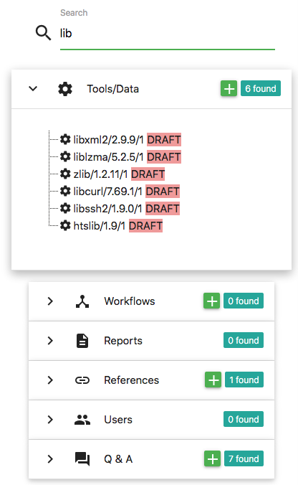
The anatomy of a tool in OpenBio.eu

Slide 53
The anatomy of a workflow in OpenBio.eu

Slide 54
The anatomy of a workflow in OpenBio.eu

Slide 55
The anatomy of a workflow in OpenBio.eu

Slide 56
The anatomy of a workflow in OpenBio.eu

Slide 57
The anatomy of a workflow in OpenBio.eu

Slide 58
Discourse Analysis
Every Tool/Data/Workflow are comment-able
There is a general QA section

Slide 59
Citation Management in OpenBio.eu
Working on: allow users to “claim” references through ORCID

Slide 60
Editing / Finalizing / Forking Research Objects
ATTENTION! This RO is not finalized. It might be edited in the future!
Only the creator can edit it
By “Finalizing” the RO is frozen for ever! No more changes are allowed!
Create a “copy” or a “fork” of a RO that belongs to you.
The creator can delete a RO as long as no other RO is using/depends on it.

Slide 61
From OpenBio.eu → CWL (and others..)

Slide 62
OpenBio.eu – Run everything everywhere
Jane’s Computer
REST API
Plug your Custom Resource Monitor
Plug your Custom Execution Engine
Export in CWL (Among others)
CWL = Common Workflow Language
NetData
AirFlow

Slide 63
Final notes
OpenBio.eu is NOT a workflow management system!
Galaxy, Nextflow, Snakemake are excellent choices for that
It is a “gluing” mechanism to connect completely heterogeneous resources through BASH
The user model is simple:
IT-savvy users: add Research Objects in BASH
Non IT-savvy users: select workflows, configure parameters, run analysis, inspect results

Slide 64
OpenBio.eu will never “force” on you
A programming Language… well except.. Bash..
A DSL (Domain Specific Language)
An Execution Engine
A Workflow modelling language
An Ontology
Notes:
OpenBio.eu will never "force" you to use..

Slide 65
OpenBio.eu – The UI

Slide 66
https://www.openbio.eu Add it to your bookmarks! NOW!
@openbioe
kantale@ics.forth.gr
openbio_eu
Open Source: https://github.com/kantale/OpenBioC BSD-3 License
Documentation: https://github.com/kantale/OpenBioC/tree/master/Documentation
The technology stack:
Django 2.1
AngularJS
Cytoscape
Materialize-CSS
Presented in: BOSC2019, BOSC2020, ISMB2019, ISMB2020, Hbio2019, BIBE2019
The Roadmap:
Add ORCID user authentication
Improve Discourse Visualization
Add moooore tools, workflows, …
Add moooore execution engines/environments
Anything that will come from your comments!
Dr. George Potamias (supervision)
Galateia Iatraki (graphs, tests, static site)
Konstantina Pitianou (Frontend)
Manos Koutoulakis (Docker, execution engine)
Dr. Alexandros Kanterakis (backend, mascot)
Dr. Lefteris Koumakis (Documentation)
Dr. Nikos Karacapilidis (Discourse, Supervision)
Nikos Kanakaris (discourse analysis)
Kostas Moumouris (Server support, deployment)
Notes:
Thank you for your time.
We are eager to hear what the community says, please live comments or send us an email,
because your feedback is what drives the development of this project!
Thanks.

Slide 67
Thanks you FOSSCOMM 2020

